Slide 1


The Tensor Product
Part 3: Vector/Covector combinations
Warning: Video contains
non-standard tensor product notation
$$\vec{e_{i}}ε^{j}$$
$$\vec{e_{i}}⊗ε^{j}$$

Slide 2

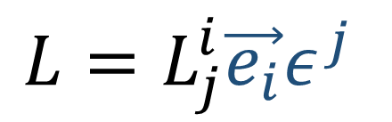








Linear Maps (new definition)…
Linear combinations of vector-covector pairs
$$L=L_{j}^{i}\vec{e_{i}}ε^{j}$$
$$\tilde{\vec{e_{j}}}=F_{j}^{i}\vec{e_{i}}$$
$$\left[\begin{aligned}v^{1} \\ v^{2}\end{aligned}\right]⊗\left[\begin{matrix}α_{1} & α_{2}\end{matrix}\right]$$
$$\vec{e_{j}}=B_{j}^{i}\tilde{\vec{e_{i}}}$$
$$\tilde{L_{j}^{i}}=B_{k}^{i}L_{l}^{k}F_{j}^{l}$$
$$L_{j}^{i}=F_{k}^{i}\tilde{L_{l}^{k}}B_{j}^{l}$$
$$\tilde{ε^{i}} =B_{j}^{i}ε^{j}$$
$$ε^{i}=F_{j}^{i}\tilde{ε^{j}}$$
$$\left[\begin{matrix}\left[\begin{aligned}L_{1}^{1} \\ L_{1}^{2}\end{aligned}\right] & \left[\begin{aligned}L_{2}^{1} \\ L_{2}^{2}\end{aligned}\right]\end{matrix}\right]$$
$$L_{j}^{i}\vec{e_{i}}ε^{j}$$
$$L_{j}^{i}v^{i}$$

Slide 3
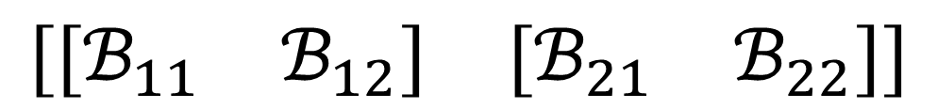
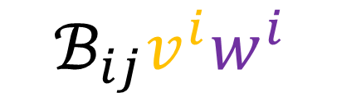
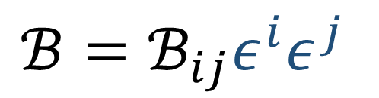
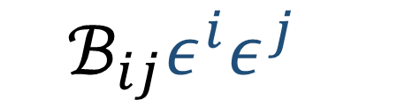

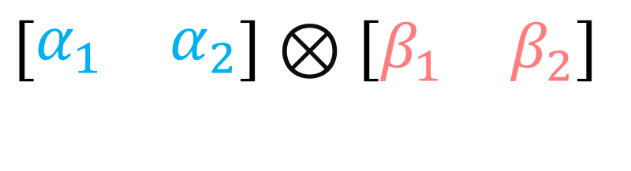
Bilinear Forms (new definition)…
Linear combinations of covector-covector pairs
$$ℬ=ℬ_{ij}ε^{i}ε^{j}$$
$$\tilde{ε^{i}} =B_{j}^{i}ε^{j}$$
$$\tilde{ℬ_{ij}}=F_{i}^{k}F_{j}^{l}ℬ_{kl}$$
$$ℬ_{ij}=B_{i}^{k}B_{j}^{l}\tilde{ℬ_{kl}}$$
$$\left[\begin{matrix}α_{1} & α_{2}\end{matrix}\right]⊗\left[\begin{matrix}β_{1} & β_{2}\end{matrix}\right]$$
$$ε^{i}=F_{j}^{i}\tilde{ε^{j}}$$
$$ℬ_{ij}ε^{i}ε^{j}$$
$$ℬ_{ij}v^{i}w^{i}$$
$$\left[\begin{matrix}\left[\begin{matrix}ℬ_{11} & ℬ_{12}\end{matrix}\right] & \left[\begin{matrix}ℬ_{21} & ℬ_{22}\end{matrix}\right]\end{matrix}\right]$$

Slide 4
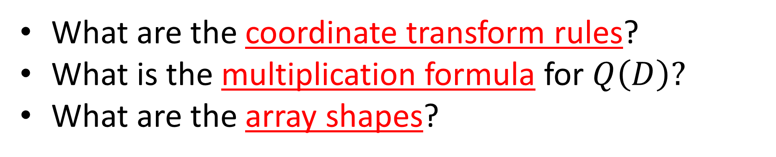
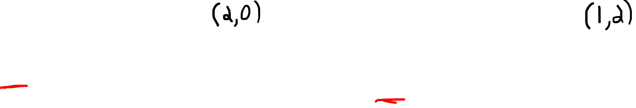

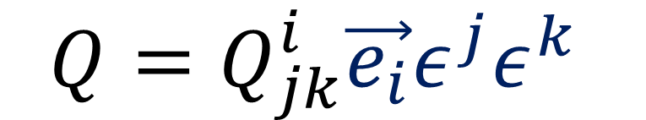
New tensors…
$$D=D^{ab}\vec{e_{a}}\vec{e_{b}}$$
$$Q=Q_{jk}^{i}\vec{e_{i}}ε^{j}ε^{k}$$
What are the coordinate transform rules?
What is the multiplication formula for $Q\left(D\right)?$
What are the array shapes?

Slide 5
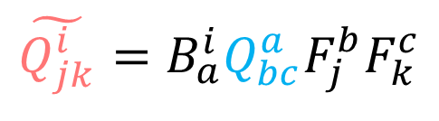
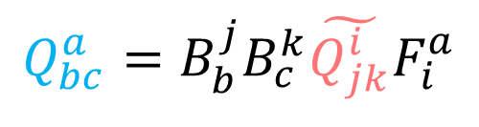
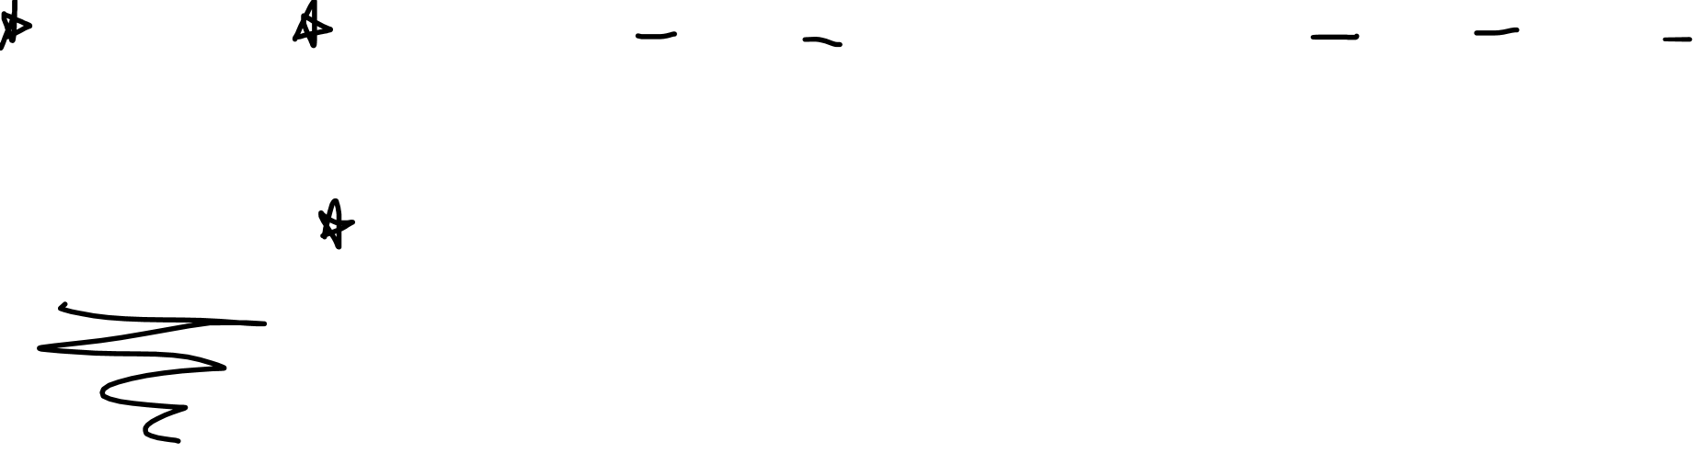


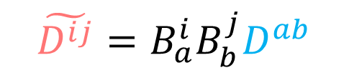
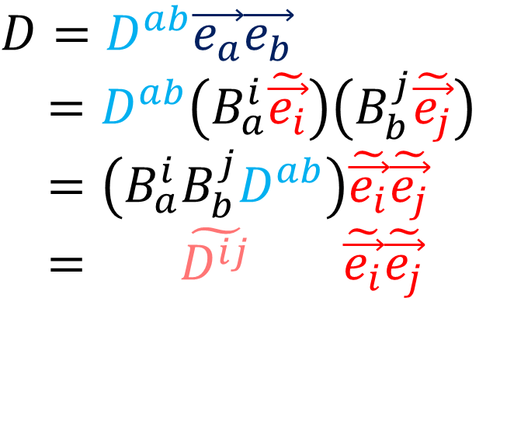
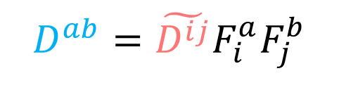
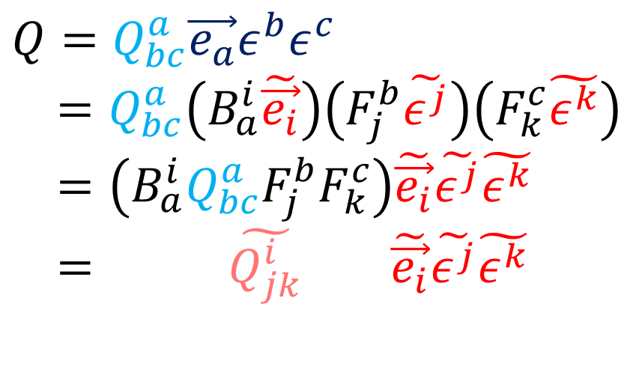
How do $D$ and $Q$ behave under a change of basis?
$$D=D^{ab}\vec{e_{a}}\vec{e_{b}}$$
$=D^{ab}\left(B_{a}^{i}\tilde{\vec{e_{i}}}\right)\left(B_{b}^{j}\tilde{\vec{e_{j}}}\right)$
$=\left(B_{a}^{i}B_{b}^{j}D^{ab}\right)\tilde{\vec{e_{i}}}\tilde{\vec{e_{j}}}$
$= \tilde{D^{ij}} \tilde{\vec{e_{i}}}\tilde{\vec{e_{j}}}$
$$Q=Q_{bc}^{a}\vec{e_{a}}ε^{b}ε^{c}$$
$=Q_{bc}^{a}\left(B_{a}^{i}\tilde{\vec{e_{i}}}\right)\left(F_{j}^{b}\tilde{ε^{j}}\right)\left(F_{k}^{c}\tilde{ε^{k}}\right)$
$=\left(B_{a}^{i}Q_{bc}^{a}F_{j}^{b}F_{k}^{c}\right)\tilde{\vec{e_{i}}}\tilde{ε^{j}}\tilde{ε^{k}}$
$= \tilde{Q_{jk}^{i}} \tilde{\vec{e_{i}}}\tilde{ε^{j}}\tilde{ε^{k}}$
$$\tilde{\vec{e_{j}}}=F_{j}^{i}\vec{e_{i}}$$
$$\vec{e_{j}}=B_{j}^{i}\tilde{\vec{e_{i}}}$$
$$\tilde{ε^{i}} =B_{j}^{i}ε^{j}$$
$$ε^{i}=F_{j}^{i}\tilde{ε^{j}}$$
$$\tilde{D^{ij}}=B_{a}^{i}B_{b}^{j}D^{ab}$$
$$\tilde{Q_{jk}^{i}}=B_{a}^{i}Q_{bc}^{a}F_{j}^{b}F_{k}^{c}$$
$$D^{ab}=\tilde{D^{ij}}F_{i}^{a}F_{j}^{b}$$
$$Q_{bc}^{a}=B_{b}^{j}B_{c}^{k}\tilde{Q_{jk}^{i}}F_{i}^{a}$$

Slide 6
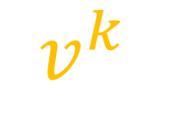
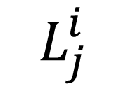
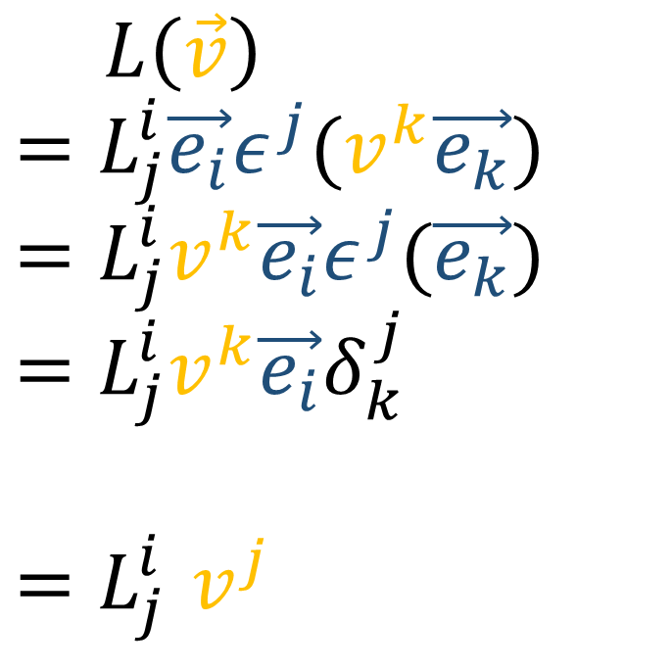

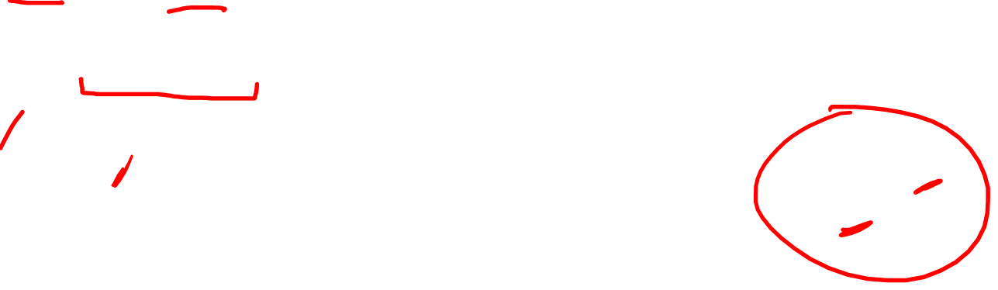
What is the formula for $Q\left(D\right)$?
$$L\left(\vec{v}\right)$$
$$=L_{j}^{i}\vec{e_{i}}ε^{j}(v^{k}\vec{e_{k}})$$
$$=L_{j}^{i}v^{k}\vec{e_{i}}ε^{j}(\vec{e_{k}})$$
$$=L_{j}^{i}v^{k}\vec{e_{i}}δ_{k}^{j}$$
$${=L}_{j}^{i}v^{j}$$
$$L_{j}^{i}$$
$$v^{k}$$
$$L_{j}^{i}v^{j}$$

Slide 7
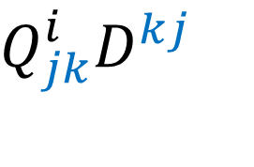
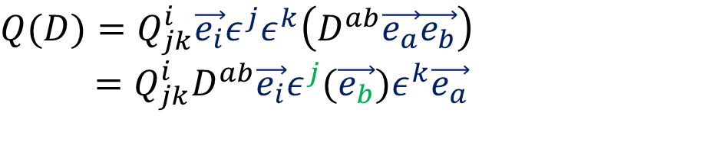
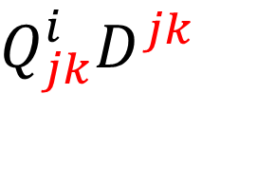
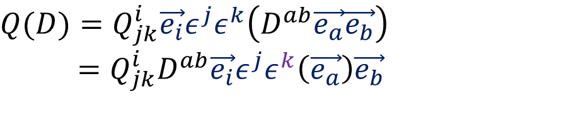
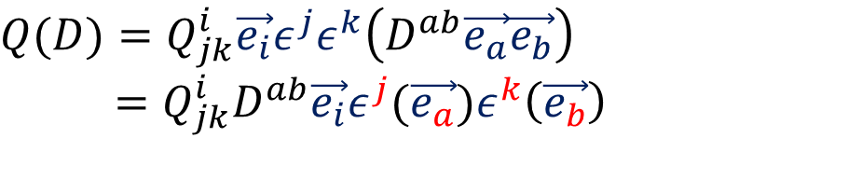
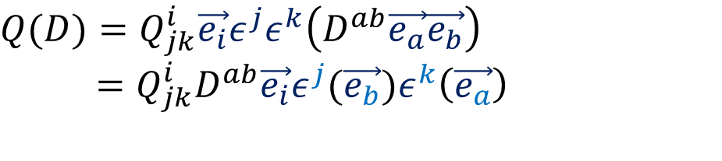
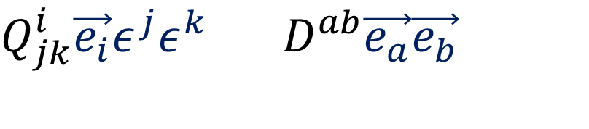
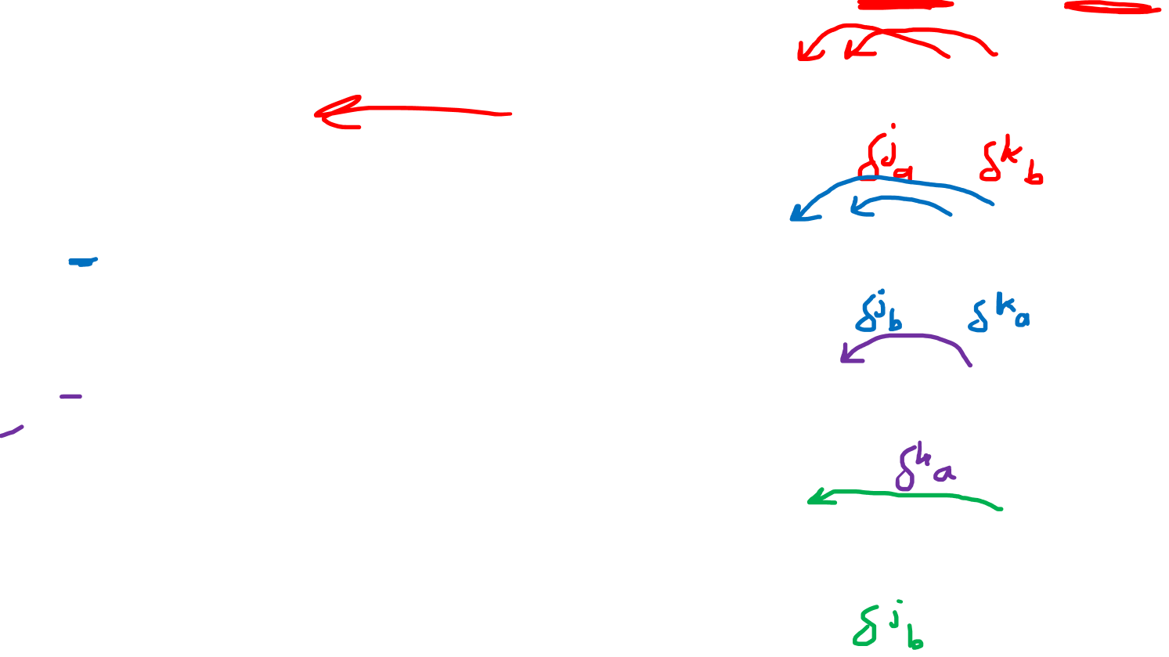
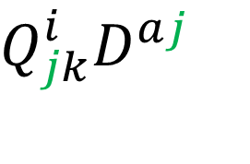
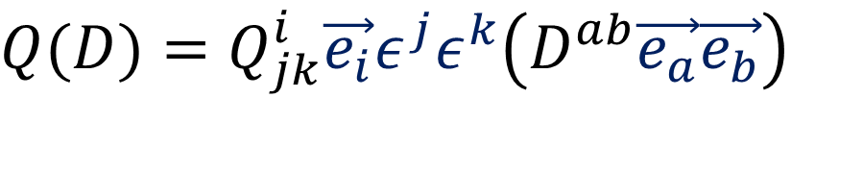
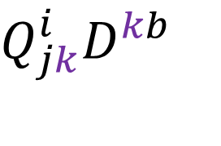
What is the formula for $Q\left(D\right)$?
$$Q_{jk}^{i}\vec{e_{i}}ε^{j}ε^{k} D^{ab}\vec{e_{a}}\vec{e_{b}}$$
$$Q(D)=Q_{jk}^{i}\vec{e_{i}}ε^{j}ε^{k}\left(D^{ab}\vec{e_{a}}\vec{e_{b}}\right)$$
$$Q_{jk}^{i}D^{jk}$$
$$Q(D)=Q_{jk}^{i}\vec{e_{i}}ε^{j}ε^{k}\left(D^{ab}\vec{e_{a}}\vec{e_{b}}\right)$$
$=Q_{jk}^{i}D^{ab}\vec{e_{i}}ε^{j}(\vec{e_{a}})ε^{k}\left(\vec{e_{b}}\right)$
$$Q_{jk}^{i}D^{kj}$$
$$Q(D)=Q_{jk}^{i}\vec{e_{i}}ε^{j}ε^{k}\left(D^{ab}\vec{e_{a}}\vec{e_{b}}\right)$$
$=Q_{jk}^{i}D^{ab}\vec{e_{i}}ε^{j}(\vec{e_{b}})ε^{k}\left(\vec{e_{a}}\right)$
$$Q_{jk}^{i}D^{kb}$$
$$Q(D)=Q_{jk}^{i}\vec{e_{i}}ε^{j}ε^{k}\left(D^{ab}\vec{e_{a}}\vec{e_{b}}\right)$$
$=Q_{jk}^{i}D^{ab}\vec{e_{i}}ε^{j}ε^{k}\left(\vec{e_{a}}\right)\vec{e_{b}}$
$$Q_{jk}^{i}D^{aj}$$
$$Q(D)=Q_{jk}^{i}\vec{e_{i}}ε^{j}ε^{k}\left(D^{ab}\vec{e_{a}}\vec{e_{b}}\right)$$
$=Q_{jk}^{i}D^{ab}\vec{e_{i}}ε^{j}(\vec{e_{b}})ε^{k}\vec{e_{a}}$

Slide 8

Shape of $D=D^{ab}\vec{e_{a}}\vec{e_{b}}$
$\left[\begin{aligned}v^{1} \\ v^{2}\end{aligned}\right]⊗$ $\left[\begin{aligned}w^{1} \\ w^{2}\end{aligned}\right]$
$$=\left[\begin{aligned}\left[\begin{aligned}v^{1} \\ v^{2}\end{aligned}\right]w^{1} \\ {\left[\begin{aligned}v^{1} \\ v^{2}\end{aligned}\right]w}^{2}\end{aligned}\right]$$
$=\left[\begin{aligned}\left[\begin{aligned}v^{1}w^{1} \\ v^{2}w^{1}\end{aligned}\right] \\ \left[\begin{aligned}v^{1}w^{2} \\ v^{2}w^{2}\end{aligned}\right]\end{aligned}\right]⇒{\left[\begin{aligned}\left[\begin{aligned}D^{11} \\ D^{21}\end{aligned}\right] \\ \left[\begin{aligned}D^{12} \\ D^{22}\end{aligned}\right]\end{aligned}\right]}_{\vec{e_{a}}\vec{e_{b}}}$

Slide 9
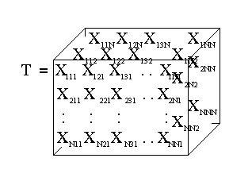

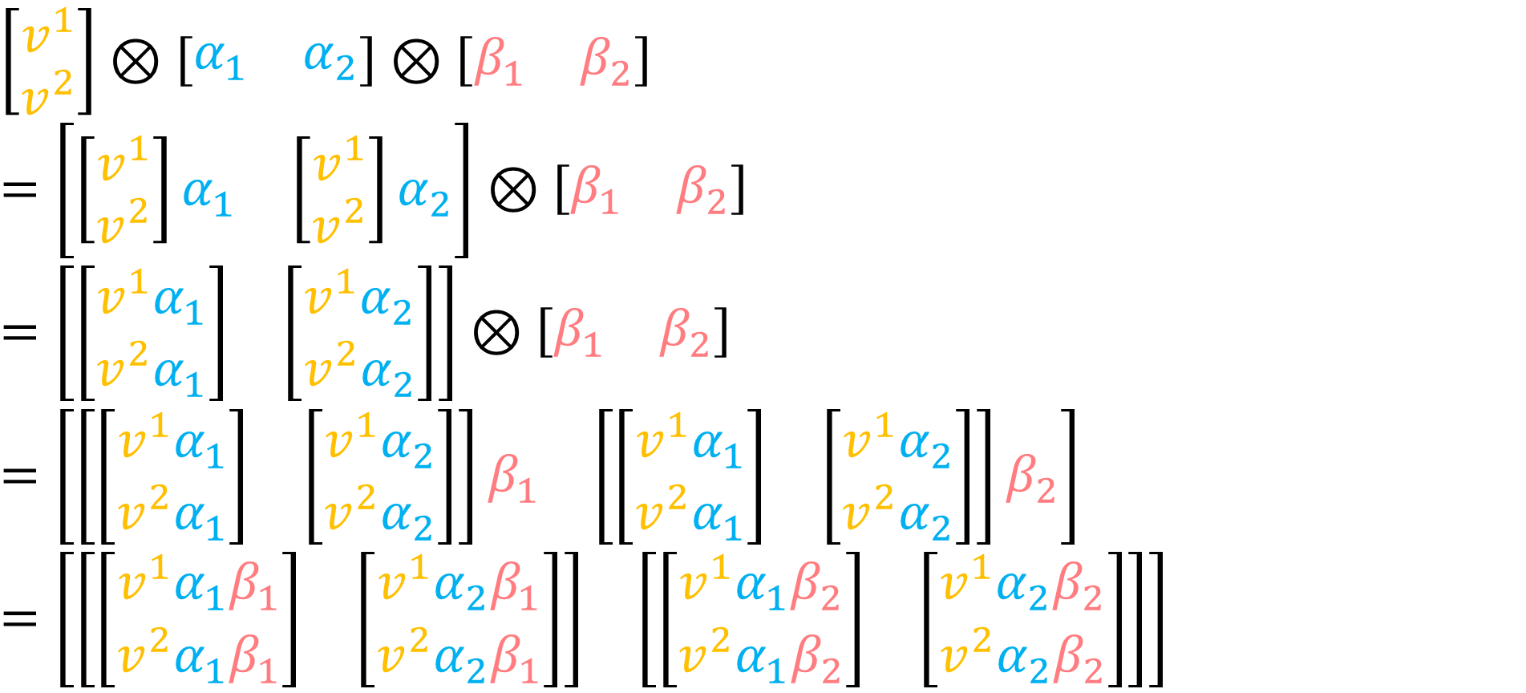
Shape of $Q=Q_{jk}^{i}\vec{e_{i}}ε^{j}ε^{k}$
$$\left[\begin{aligned}v^{1} \\ v^{2}\end{aligned}\right]⊗\left[\begin{matrix}α_{1} & α_{2}\end{matrix}\right]⊗\left[\begin{matrix}β_{1} & β_{2}\end{matrix}\right]$$
$$=\left[\left[\begin{aligned}v^{1} \\ v^{2}\end{aligned}\right]\begin{matrix}α_{1} & \left[\begin{aligned}v^{1} \\ v^{2}\end{aligned}\right]α_{2}\end{matrix}\right]⊗\left[\begin{matrix}β_{1} & β_{2}\end{matrix}\right]$$
$$=\left[\begin{matrix}\left[\begin{aligned}v^{1}α_{1} \\ v^{2}α_{1}\end{aligned}\right] & \left[\begin{aligned}v^{1}α_{2} \\ v^{2}α_{2}\end{aligned}\right]\end{matrix}\right]⊗\left[\begin{matrix}β_{1} & β_{2}\end{matrix}\right]$$
$$=\left[\begin{matrix}\left[\begin{matrix}\left[\begin{aligned}v^{1}α_{1} \\ v^{2}α_{1}\end{aligned}\right] & \left[\begin{aligned}v^{1}α_{2} \\ v^{2}α_{2}\end{aligned}\right]\end{matrix}\right]β_{1} & {\left[\begin{matrix}\left[\begin{aligned}v^{1}α_{1} \\ v^{2}α_{1}\end{aligned}\right] & \left[\begin{aligned}v^{1}α_{2} \\ v^{2}α_{2}\end{aligned}\right]\end{matrix}\right]β}_{2}\end{matrix}\right]$$
$$=\left[\begin{matrix}\left[\begin{matrix}\left[\begin{aligned}v^{1}α_{1}β_{1} \\ v^{2}α_{1}β_{1}\end{aligned}\right] & \left[\begin{aligned}v^{1}α_{2}β_{1} \\ v^{2}α_{2}β_{1}\end{aligned}\right]\end{matrix}\right] & \left[\begin{matrix}\left[\begin{aligned}v^{1}α_{1}β_{2} \\ v^{2}α_{1}β_{2}\end{aligned}\right] & \left[\begin{aligned}v^{1}α_{2}β_{2} \\ v^{2}α_{2}β_{2}\end{aligned}\right]\end{matrix}\right]\end{matrix}\right]$$

Slide 10
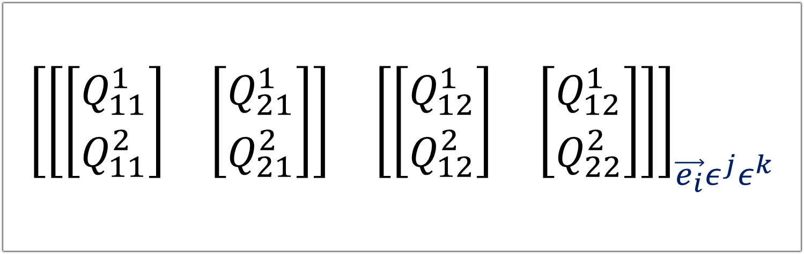
Shape of $Q=Q_{jk}^{i}\vec{e_{i}}ε^{j}ε^{k}$
$$\left[\begin{aligned}v^{1} \\ v^{2}\end{aligned}\right]⊗\left[\begin{matrix}α_{1} & α_{2}\end{matrix}\right]⊗\left[\begin{matrix}β_{1} & β_{2}\end{matrix}\right]$$
$$=\left[\left[\begin{aligned}v^{1} \\ v^{2}\end{aligned}\right]\begin{matrix}α_{1} & \left[\begin{aligned}v^{1} \\ v^{2}\end{aligned}\right]α_{2}\end{matrix}\right]⊗\left[\begin{matrix}β_{1} & β_{2}\end{matrix}\right]$$
$$=\left[\begin{matrix}\left[\begin{aligned}v^{1}α_{1} \\ v^{2}α_{1}\end{aligned}\right] & \left[\begin{aligned}v^{1}α_{2} \\ v^{2}α_{2}\end{aligned}\right]\end{matrix}\right]⊗\left[\begin{matrix}β_{1} & β_{2}\end{matrix}\right]$$
$$=\left[\begin{matrix}\left[\begin{matrix}\left[\begin{aligned}v^{1}α_{1} \\ v^{2}α_{1}\end{aligned}\right] & \left[\begin{aligned}v^{1}α_{2} \\ v^{2}α_{2}\end{aligned}\right]\end{matrix}\right]β_{1} & {\left[\begin{matrix}\left[\begin{aligned}v^{1}α_{1} \\ v^{2}α_{1}\end{aligned}\right] & \left[\begin{aligned}v^{1}α_{2} \\ v^{2}α_{2}\end{aligned}\right]\end{matrix}\right]β}_{2}\end{matrix}\right]$$
$$=\left[\begin{matrix}\left[\begin{matrix}\left[\begin{aligned}v^{1}α_{1}β_{1} \\ v^{2}α_{1}β_{1}\end{aligned}\right] & \left[\begin{aligned}v^{1}α_{2}β_{1} \\ v^{2}α_{2}β_{1}\end{aligned}\right]\end{matrix}\right] & \left[\begin{matrix}\left[\begin{aligned}v^{1}α_{1}β_{2} \\ v^{2}α_{1}β_{2}\end{aligned}\right] & \left[\begin{aligned}v^{1}α_{2}β_{2} \\ v^{2}α_{2}β_{2}\end{aligned}\right]\end{matrix}\right]\end{matrix}\right]$$
$${\left[\begin{matrix}\left[\begin{matrix}\left[\begin{aligned}Q_{11}^{1} \\ Q_{11}^{2}\end{aligned}\right] & \left[\begin{aligned}Q_{21}^{1} \\ Q_{21}^{2}\end{aligned}\right]\end{matrix}\right] & \left[\begin{matrix}\left[\begin{aligned}Q_{12}^{1} \\ Q_{12}^{2}\end{aligned}\right] & \left[\begin{aligned}Q_{12}^{1} \\ Q_{22}^{2}\end{aligned}\right]\end{matrix}\right]\end{matrix}\right]}_{{\vec{e_{i}}ε^{j}ε}^{k}}$$

Slide 11
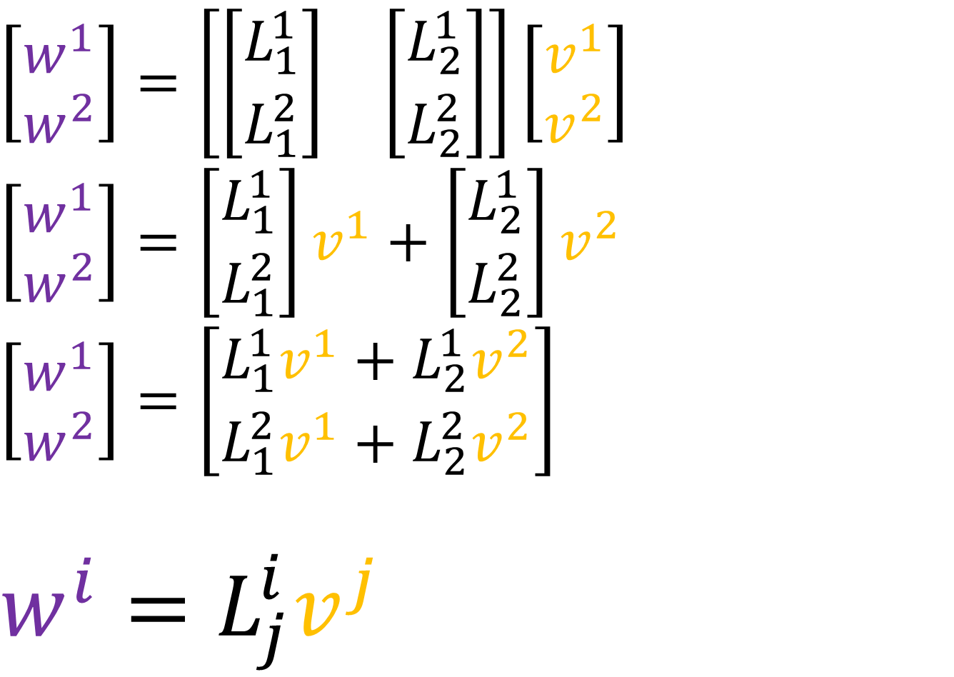
Array multiplication
$$\left[\begin{aligned}w^{1} \\ w^{2}\end{aligned}\right]=\left[\begin{matrix}\left[\begin{aligned}L_{1}^{1} \\ L_{1}^{2}\end{aligned}\right] & \left[\begin{aligned}L_{2}^{1} \\ L_{2}^{2}\end{aligned}\right]\end{matrix}\right]\left[\begin{aligned}v^{1} \\ v^{2}\end{aligned}\right]$$
$$\left[\begin{aligned}w^{1} \\ w^{2}\end{aligned}\right]=\left[\begin{aligned}L_{1}^{1} \\ L_{1}^{2}\end{aligned}\right]v^{1}+\left[\begin{aligned}L_{2}^{1} \\ L_{2}^{2}\end{aligned}\right]v^{2}$$
$$\left[\begin{aligned}w^{1} \\ w^{2}\end{aligned}\right]=\left[\begin{aligned}L_{1}^{1}v^{1}+L_{2}^{1}v^{2} \\ L_{1}^{2}v^{1}+L_{2}^{2}v^{2}\end{aligned}\right]$$
$$w^{i}=L_{j}^{i}v^{j}$$

Slide 12
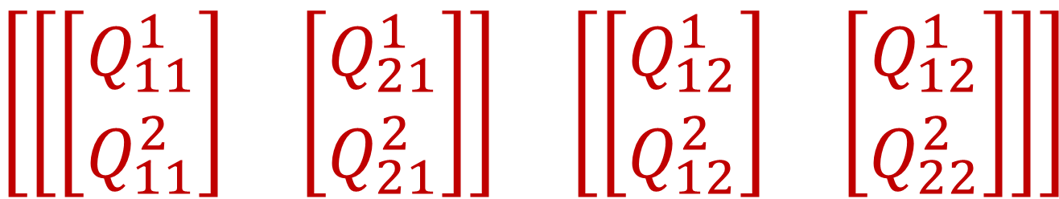
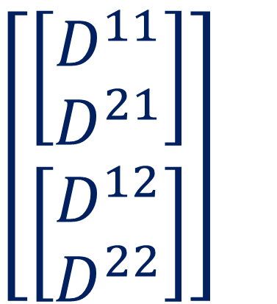
Array multiplication
$\left[\begin{matrix}\left[\begin{matrix}\left[\begin{aligned}Q_{11}^{1} \\ Q_{11}^{2}\end{aligned}\right] & \left[\begin{aligned}Q_{21}^{1} \\ Q_{21}^{2}\end{aligned}\right]\end{matrix}\right] & \left[\begin{matrix}\left[\begin{aligned}Q_{12}^{1} \\ Q_{12}^{2}\end{aligned}\right] & \left[\begin{aligned}Q_{12}^{1} \\ Q_{22}^{2}\end{aligned}\right]\end{matrix}\right]\end{matrix}\right]$
Type (1,2)
$\left[\begin{aligned}\left[\begin{aligned}D^{11} \\ D^{21}\end{aligned}\right] \\ \left[\begin{aligned}D^{12} \\ D^{22}\end{aligned}\right]\end{aligned}\right]$
Type (2,0)

Slide 13
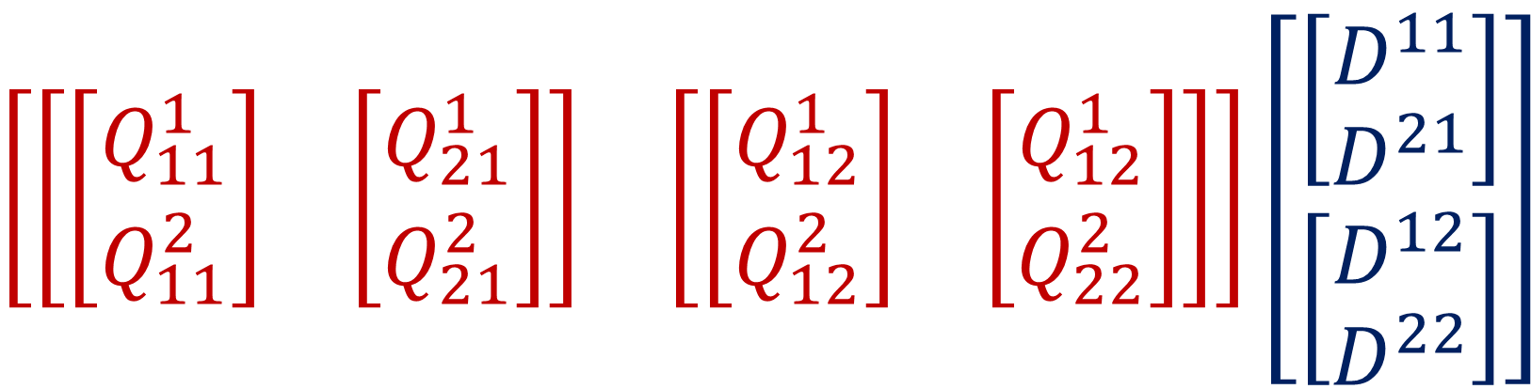




Array multiplication
$$\left[\begin{matrix}\left[\begin{matrix}\left[\begin{aligned}Q_{11}^{1} \\ Q_{11}^{2}\end{aligned}\right] & \left[\begin{aligned}Q_{21}^{1} \\ Q_{21}^{2}\end{aligned}\right]\end{matrix}\right] & \left[\begin{matrix}\left[\begin{aligned}Q_{12}^{1} \\ Q_{12}^{2}\end{aligned}\right] & \left[\begin{aligned}Q_{12}^{1} \\ Q_{22}^{2}\end{aligned}\right]\end{matrix}\right]\end{matrix}\right]\left[\begin{aligned}\left[\begin{aligned}D^{11} \\ D^{21}\end{aligned}\right] \\ \left[\begin{aligned}D^{12} \\ D^{22}\end{aligned}\right]\end{aligned}\right]$$
$$Q_{jk}^{i}D^{jk}$$
$$Q_{jk}^{i}D^{kj}$$
$$Q_{jk}^{i}D^{kb}$$
$$Q_{jk}^{i}D^{aj}$$

Slide 14


$$\left[\begin{matrix}\left[\begin{matrix}\left[\begin{aligned}Q_{11}^{1} \\ Q_{11}^{2}\end{aligned}\right] & \left[\begin{aligned}Q_{21}^{1} \\ Q_{21}^{2}\end{aligned}\right]\end{matrix}\right] & \left[\begin{matrix}\left[\begin{aligned}Q_{12}^{1} \\ Q_{12}^{2}\end{aligned}\right] & \left[\begin{aligned}Q_{12}^{1} \\ Q_{22}^{2}\end{aligned}\right]\end{matrix}\right]\end{matrix}\right]\left[\begin{aligned}\left[\begin{aligned}D^{11} \\ D^{21}\end{aligned}\right] \\ \left[\begin{aligned}D^{12} \\ D^{22}\end{aligned}\right]\end{aligned}\right]$$
$$Q_{jk}^{i}\vec{e_{i}}ε^{j}ε^{k}\left(D^{ab}\vec{e_{a }}\vec{e_{b}}\right)$$

Slide 15




$$Q_{jk}^{i}D^{jk}$$
$$Q_{jk}^{i}D^{kj}$$
$$Q_{jk}^{i}D^{kb}$$
$$Q_{jk}^{i}D^{aj}$$

Slide 16


$$Q_{jk}^{i}\vec{e_{i}}ε^{j}ε^{k}$$
$$D^{ab}\vec{e_{a }}\vec{e_{b}}$$

Slide 17


$$Q=Q_{jk}^{i}\vec{e_{i}}ε^{j}ε^{k}=\tilde{Q_{jk}^{i}}\tilde{\vec{e_{i}}}\tilde{ε^{j}}\tilde{ε^{k}}$$
$$D=D^{ab}\vec{e_{a }}\vec{e_{b}}=\tilde{D^{ab}}\tilde{\vec{e_{a }}}\tilde{\vec{e_{b}}}$$

Slide 18








3. Tensor = a collection of vectors and covectors combined together using the tensor product
$Q=Q_{jk}^{i}\vec{e_{i}}ε^{j}ε^{k}$ $D=D^{ab}\vec{e_{a}}\vec{e_{b}}$
$$\tilde{\vec{e_{j}}}=F_{j}^{i}\vec{e_{i}}$$
$$Q_{jk}^{i}D^{jk}$$
$$Q_{jk}^{i}D^{kj}$$
$$\vec{e_{j}}=B_{j}^{i}\tilde{\vec{e_{i}}}$$
$$\tilde{ε^{i}} =B_{j}^{i}ε^{j}$$
$$Q_{jk}^{i}D^{kb}$$
$$Q_{jk}^{i}D^{aj}$$
$$ε^{i}=F_{j}^{i}\tilde{ε^{j}}$$
Notes:
More advanced… You’ve possibly never heard of a covector. Possibly never heard of the tensor product before. But this definition is really nice because we only really need to understand 3 things. We know almost all the basics

